Slide 1
VOLCANICS ENVIRONMENTS
LUIS MELO
DAVID MARTINEZ

Slide 2
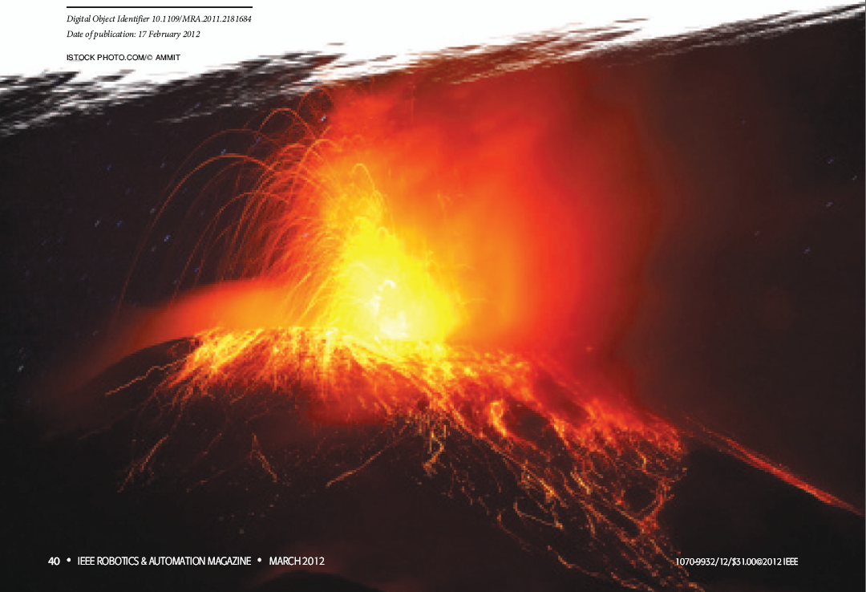
ROBOTS FOR EXPLORATION AND MEASUREMENT

Slide 3
IMPORTANCE OF ROBOTS FOR MEASUREMENTS IN VOLCANOES
Reduce the level of risk involved for volcanologists who are working too closely to volcanic vents during eruptive phenomena.
Measurement of variables relevant to the investigation of volcanic activity (visual, thermal images, gas analysis and sampling).

Slide 4
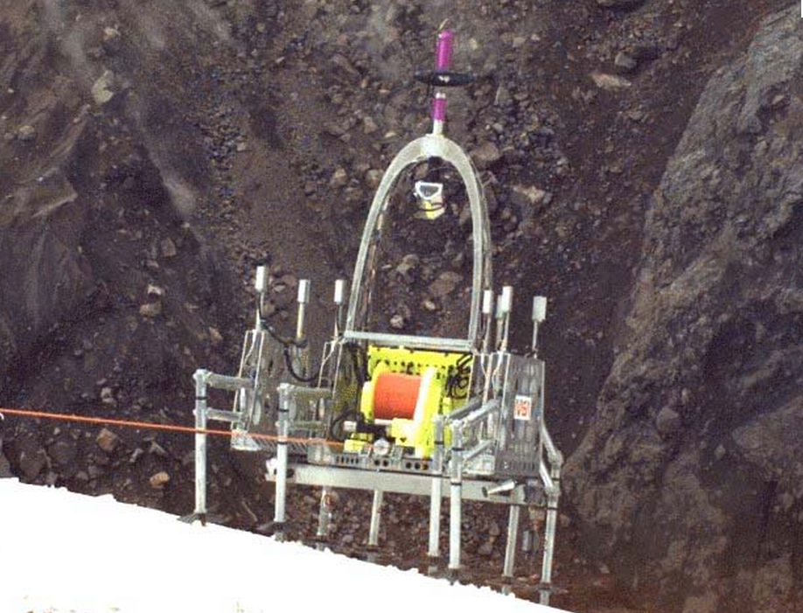
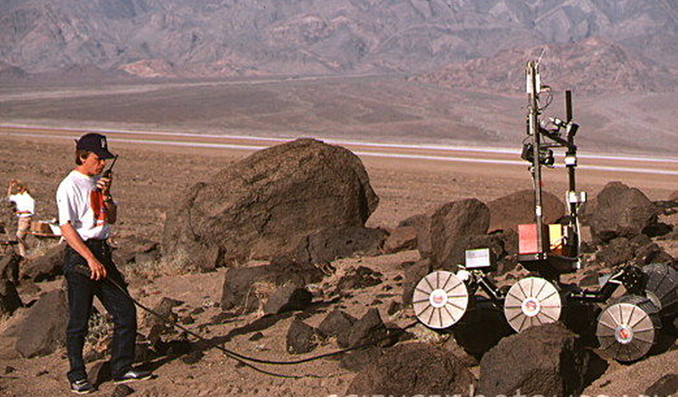
OTHER PROJECTS CONCERNING ROBOTS AND VOLCANOES
Rover Marsokhod
Dante II
http://www.google.com.co/imgres?um=1&hl=es&biw=1280&bih=652&tbm=isch&tbnid=aZWmQohrXH0awM:&imgrefurl=http://www.sciencephoto.com/media/337613/enlarge&imgurl=http://www.sciencephoto.com/image/337613/large/S6100017-Testing_of_CIS_Mars_Rover_in_USA-SPL.jpg&w=530&h=354&ei=VHw6UO2rFsrr0gHXloDICA&zoom=1&iact=hc&vpx=944&vpy=160&dur=3545&hovh=184&hovw=276&tx=142&ty=116&sig=115134599814452732756&page=1&tbnh=144&tbnw=188&start=0&ndsp=18&ved=1t:429,r:5,s:0,i:82
http://www.google.com.co/imgres?num=10&um=1&hl=es&sa=N&biw=1280&bih=652&tbm=isch&tbnid=QOARR_r7f2PVPM:&imgrefurl=http://syahbta.blogspot.com/2010/10/4-kandidat-pengganti-mbah-marijan.html&imgurl=http://3.bp.blogspot.com/_xkLSgEA_MTQ/TMi9ZmxWtII/AAAAAAAAALo/eruICiU7Dls/s1600/Dante%252B1.jpg&w=640&h=480&ei=5Xs6UM2YN8W40AGtk4GABQ&zoom=1&iact=hc&vpx=664&vpy=321&dur=562&hovh=178&hovw=240&tx=131&ty=105&sig=115134599814452732756&page=1&tbnh=142&tbnw=194&start=0&ndsp=21&ved=1t:429,r:10,s:0,i:101

Slide 5
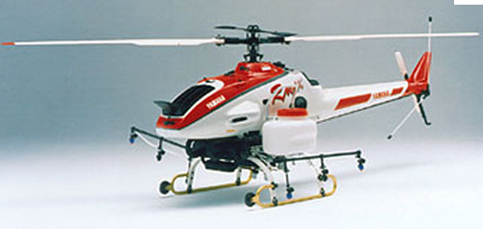
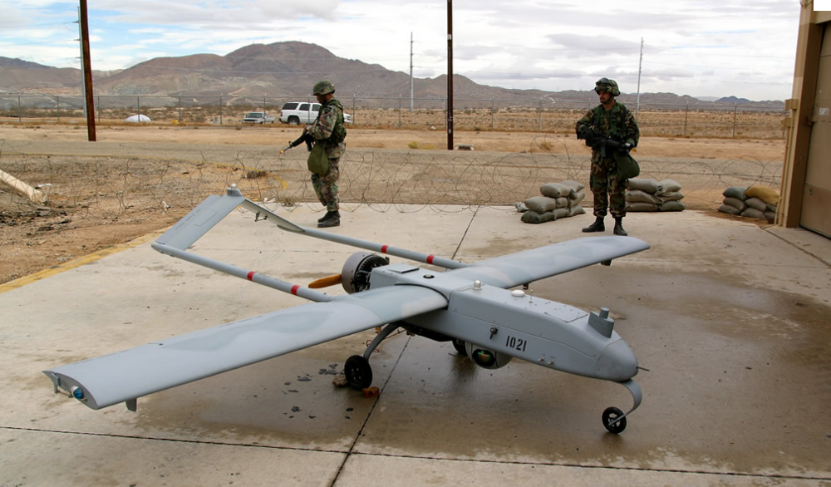
OTHER PROJECTS CONCERNING ROBOTS AND VOLCANOES
helicóptero Yamaha RMAX
http://www.google.com.co/imgres?um=1&hl=es&sa=X&biw=1280&bih=652&tbm=isch&tbnid=iEhQVHTH0uN_OM:&imgrefurl=http://www.yamaha-motor.co.jp/global/news/2002/02/06/sky.html&imgurl=http://www.yamaha-motor.co.jp/global/news/2002/02/06/images/hericopter.jpg&w=350&h=188&ei=YX06UOyzIcPe0gHpp4CgDA&zoom=1&iact=hc&vpx=185&vpy=336&dur=445&hovh=150&hovw=278&tx=141&ty=84&sig=115134599814452732756&page=1&tbnh=104&tbnw=194&start=0&ndsp=15&ved=1t:429,r:5,s:0,i:83
UAV Makers AAI & Aerosonde
http://www.defenseindustrydaily.com/textron-buys-uav-makers-aai-aerosonde-03968/

Slide 6
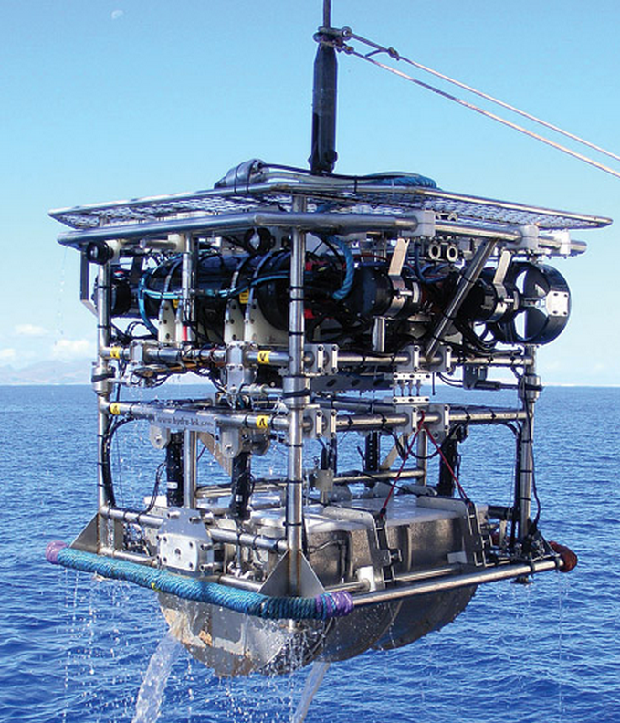
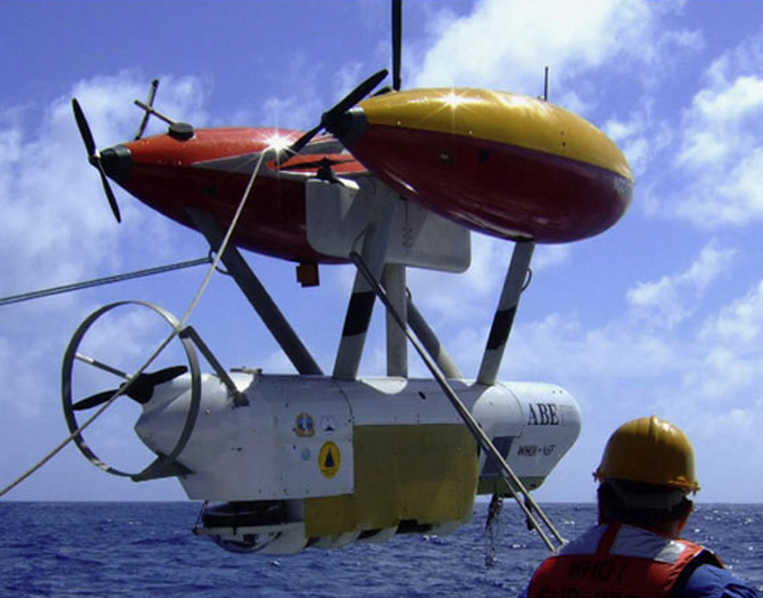
OTHER PROJECTS CONCERNING ROBOTS AND VOLCANOES
Autonomous Benthic Explorer (ABE)
http://oceanexplorer.noaa.gov/explorations/10chile/background/plan/media/missionplan3_es.html
http://www.intoceansys.co.uk/articles-detail.php?iss=0000000011&acl=0000000073
HyBIS

Slide 7
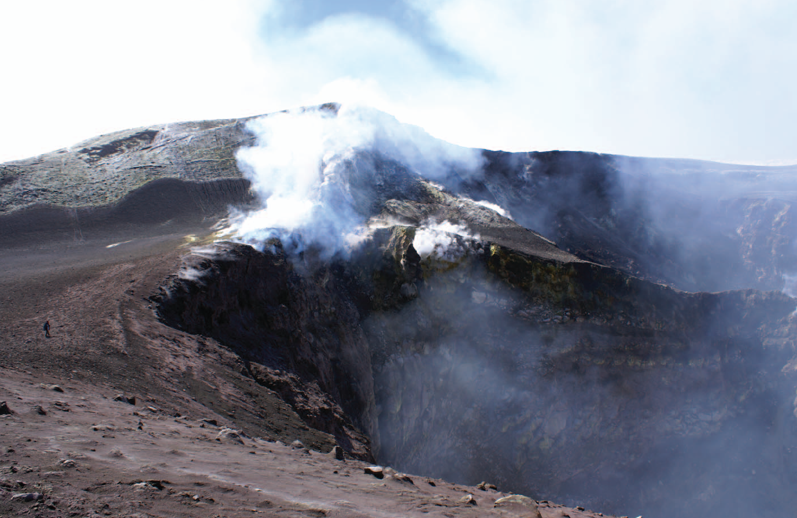

Slide 8
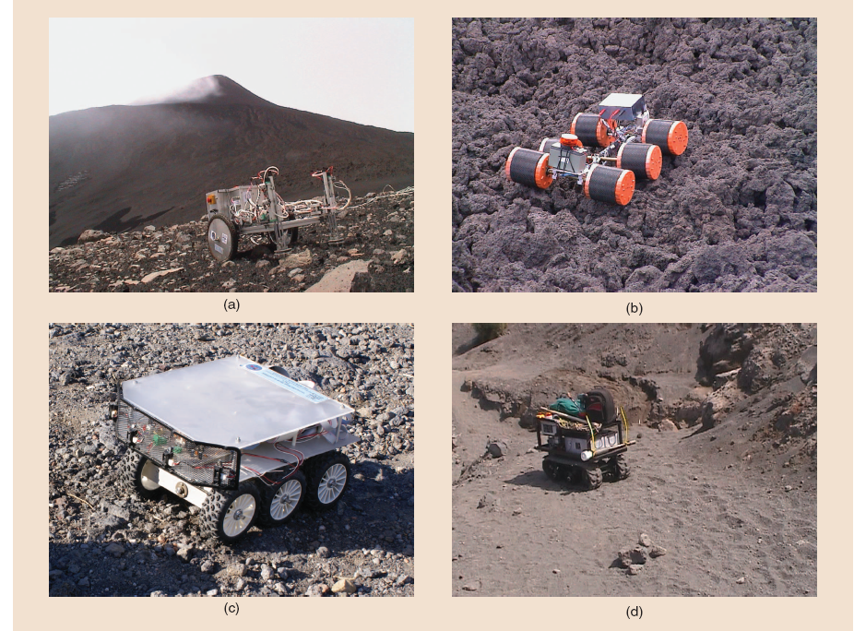
Prototype robots for volcanic exploration: (a) Wheeleg in action on Mt. Etna, (b) M6 on volcanic terrain, (c) P6W robot, and (d) U-Go robot during a teleoperated outdoor test on the island of Vulcano.

Slide 9
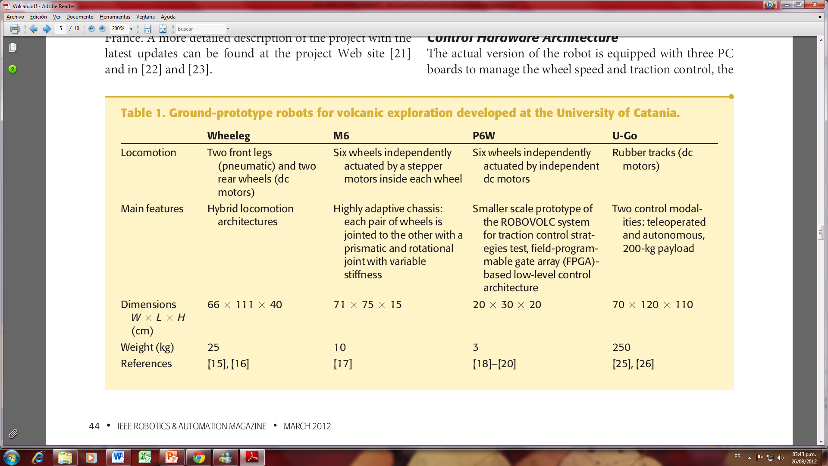
TABLE 1. GROUND-PROTOTYPE ROBOTS FOR VOLCANIC EXPLORATION DEVELOPED AT THE UNIVERSITY OF CATANIA.

Slide 10
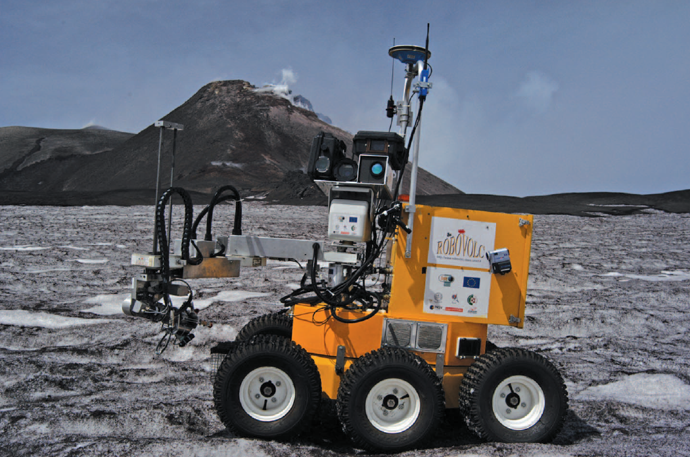
ROBOVOLC in action on top of Mt. Etna
(the southeast crater is in the background).

Slide 11
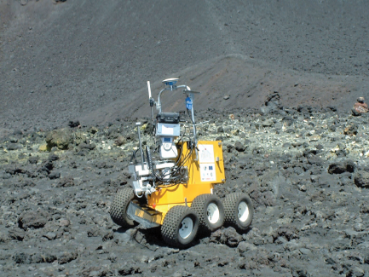
THE MECHANICAL PLATFORM
ROBOVOLC in action on rocky terrain

Slide 12
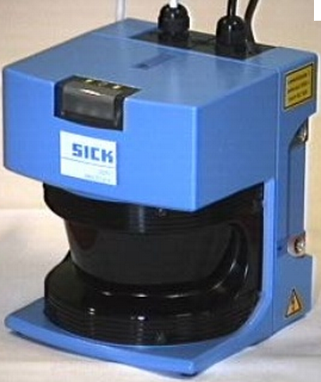
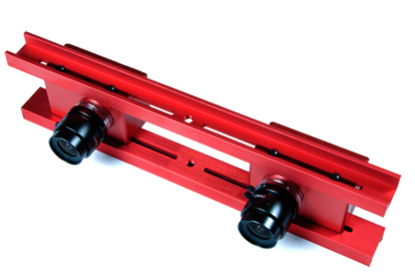
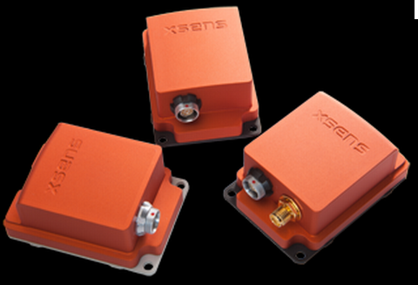
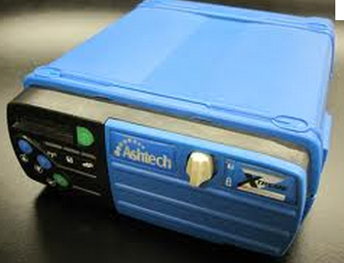
NAVIGATION AND LOCALIZATION SYSTEM
http://www.edvantek.com/PDFs/sth-dcsg-var-data-sheet.pdf
laser range finder SICK LMS200
stereo camera (Videre, STH-MDCS3-VAR)
http://www.robotsinsearch.com/sick-20030106-pi-294.html?image=0
http://www.xsens.com/
http://lens.ou.edu/
global navigation satellite system (GNSS) receiver (Ashtech ZXtreme)
attitude and heading reference system (AHRS) (X-SensMTi)

